Slide 1
Using REST API in Drupal8
REST stands for Representational State Transfer. REST is a web standards based architecture and uses HTTP Protocol for data communication. It revolves around resources where every component is a resource and a resource is accessed by a common interface using HTTP standard methods.
RESTful Web Services are basically REST Architecture based Web Services. In REST Architecture everything is a resource. RESTful web services are light weight, highly scalable and maintainable and are very commonly used to create APIs for web-based applications.

Slide 2
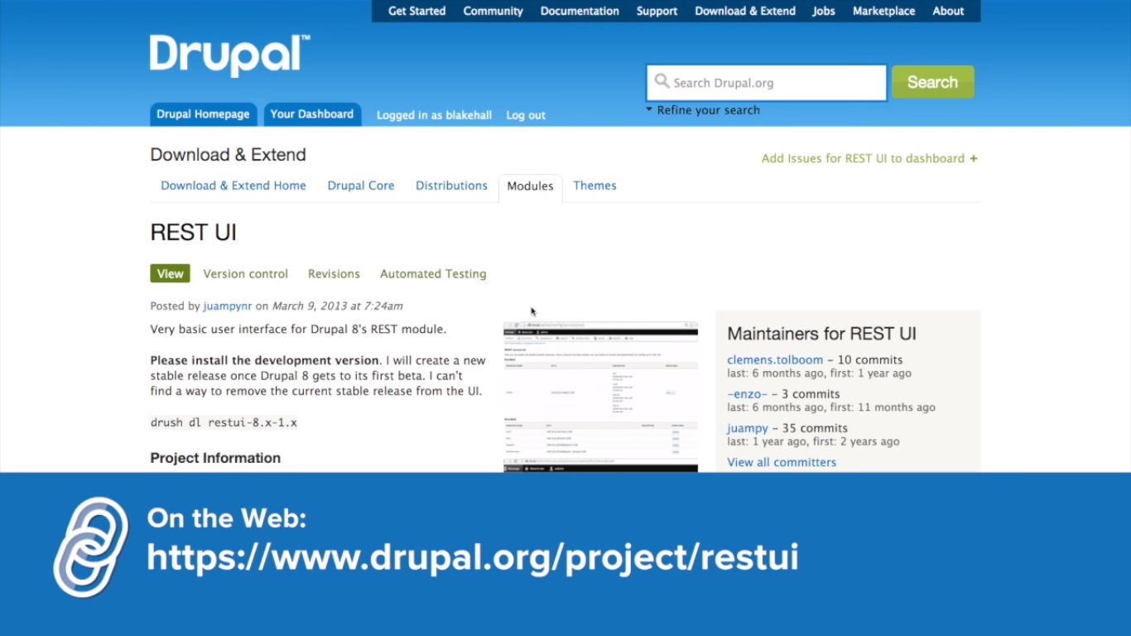
REST API Installation with Drupal8

Slide 3
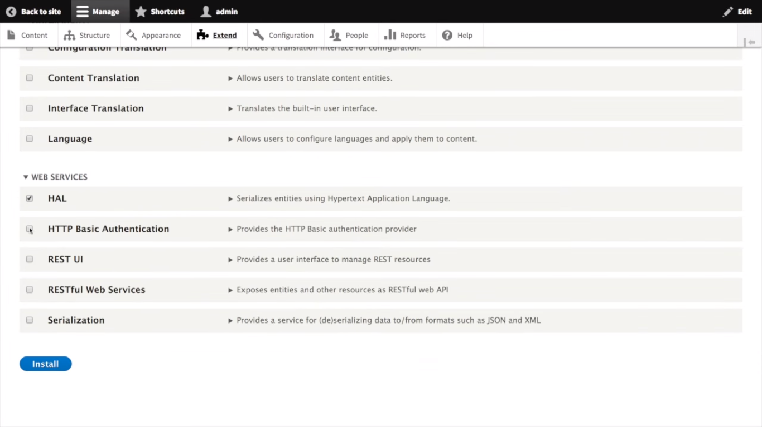
REST API Installation with Drupal8

Slide 4
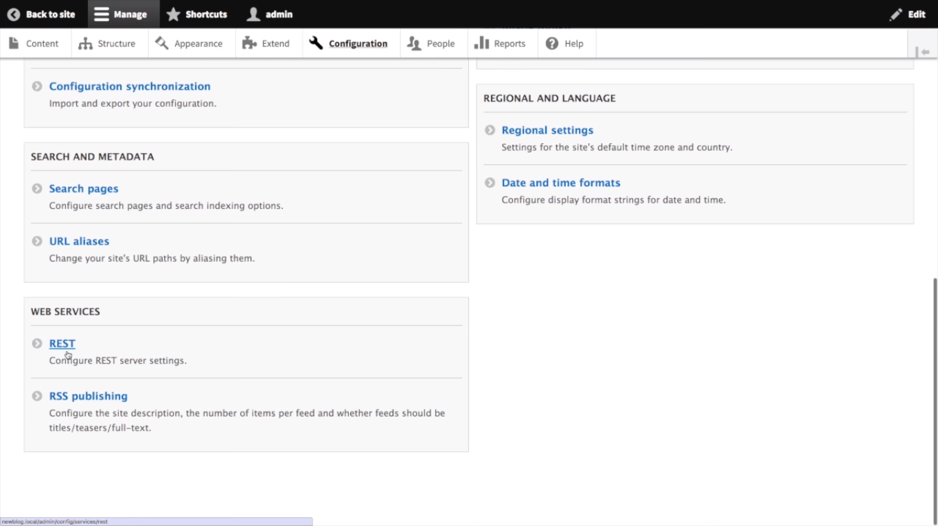
REST API Installation with Drupal8

Slide 5
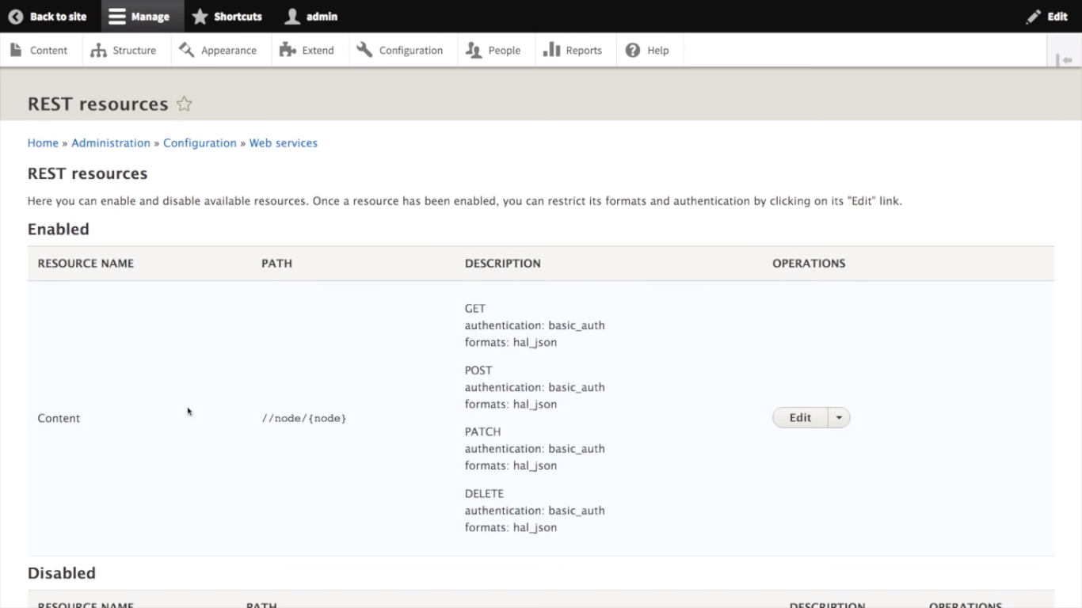
REST API Installation with Drupal8

Slide 6
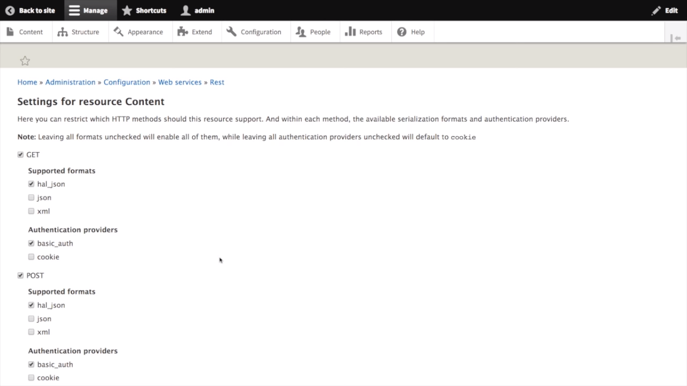
REST API Installation with Drupal8

Slide 7
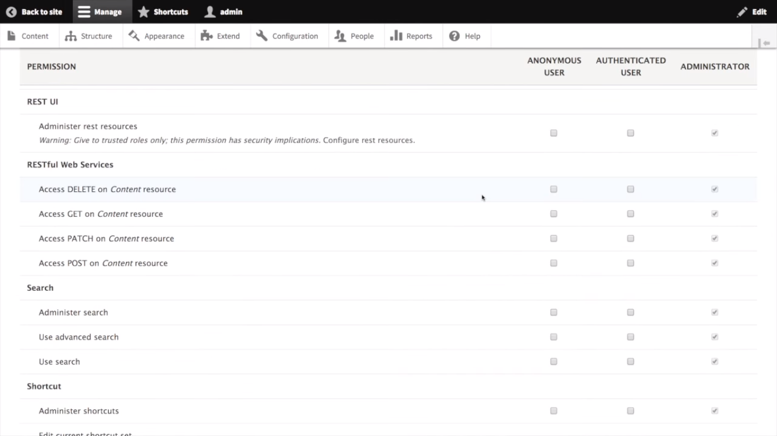
REST API Installation with Drupal8

Slide 8
REST API Configration
Steps :
Create Content type marksdetail
Add fields with content type
Name, Subject, Marks
Create student records for the marksdetail
Create view for marksdetail
Edit title (remove the link) and add fields to the view
Link REST API EXPORT setting and put REST EXPORT PATH
Represent the data as JSON , XML, HTML etc
View the data using JSON EDITOR
https://codebeautify.org/online-json-editor
Do data manipulation like GET,PUT,UPDATE etc using POSTMAN

Slide 9
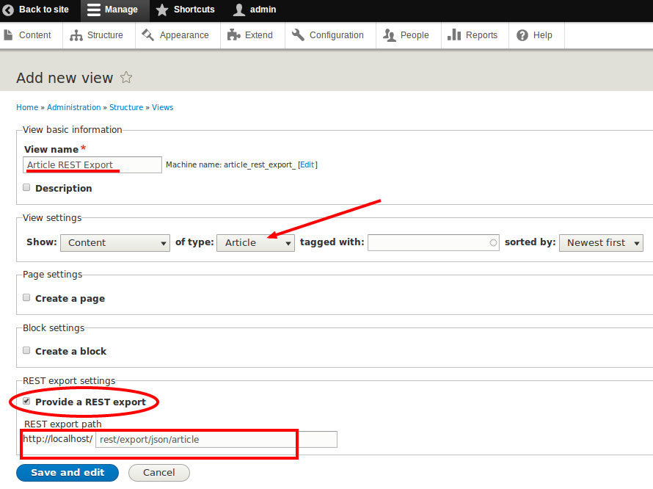
REST API Configration

Slide 10
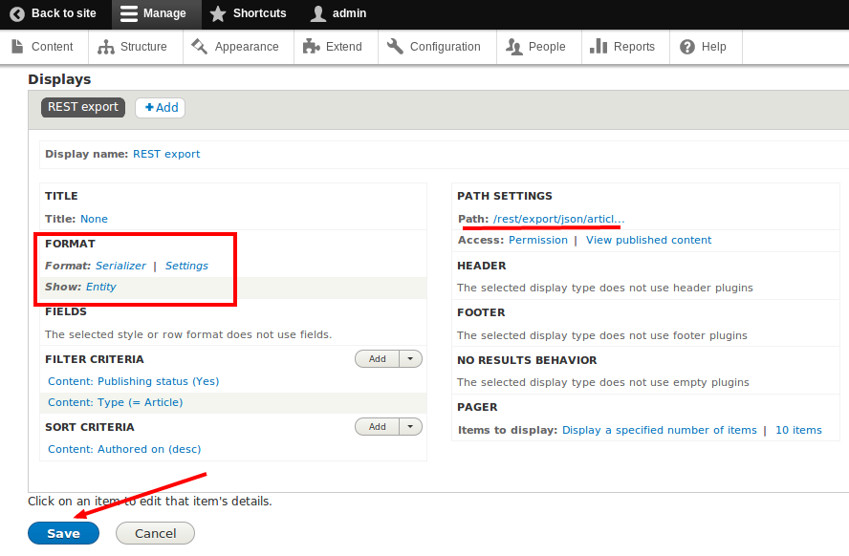
REST API Configuration

Slide 11
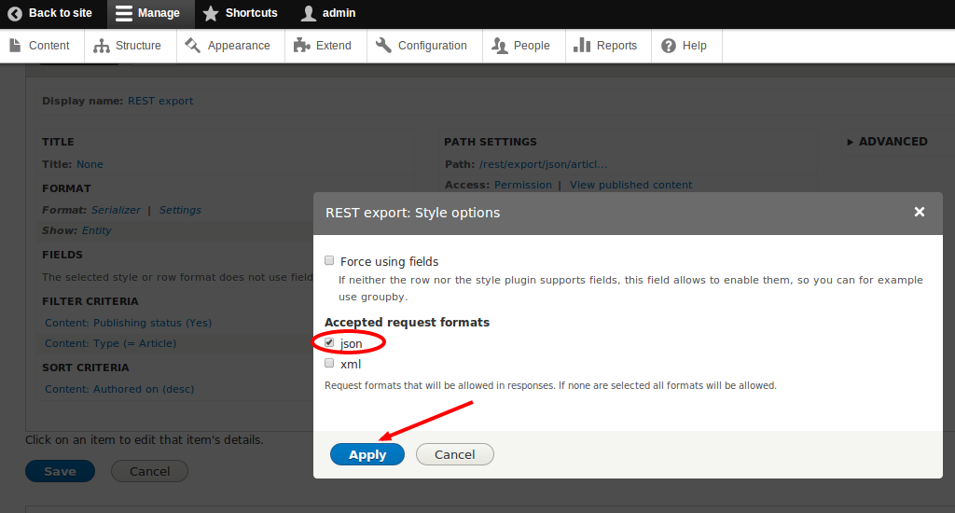
REST API Configuration
Tick the box against “json” since the data will be in json format. Click “Apply”. Finally, save the view by clicking the "Save" button.

Slide 12
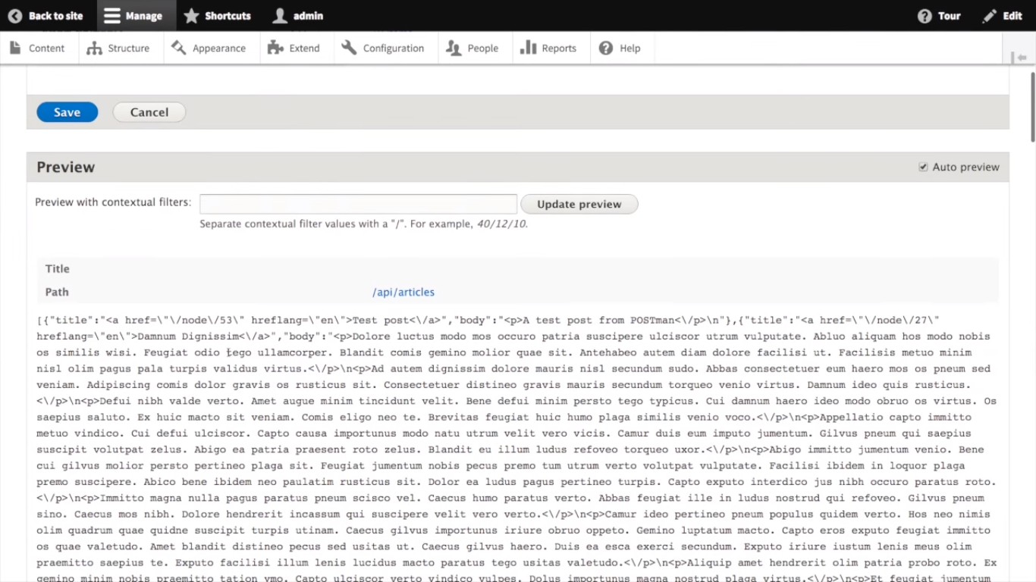
REST API Configration

Slide 13
REST API Configration
Once you saved the view, you can test the end point using any REST client. Here, we are using "Advanced REST client", an extension of Google Chrome browser. For installing this, type in "https://chrome.google.com/webstore/category/apps" in your Google Chrome browser. Search for "rest client" as shown in the image below. You will find "Advanced REST client". Click "FREE" to install the application.

Slide 14
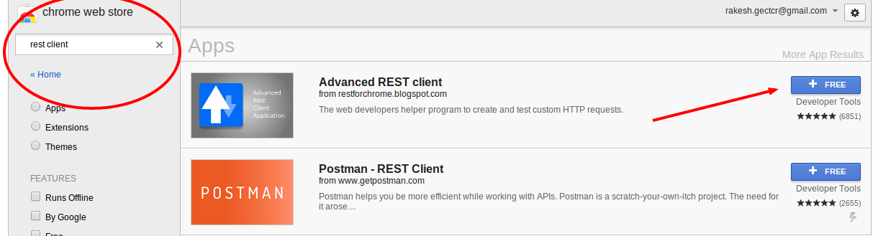
REST API Configration

Slide 15
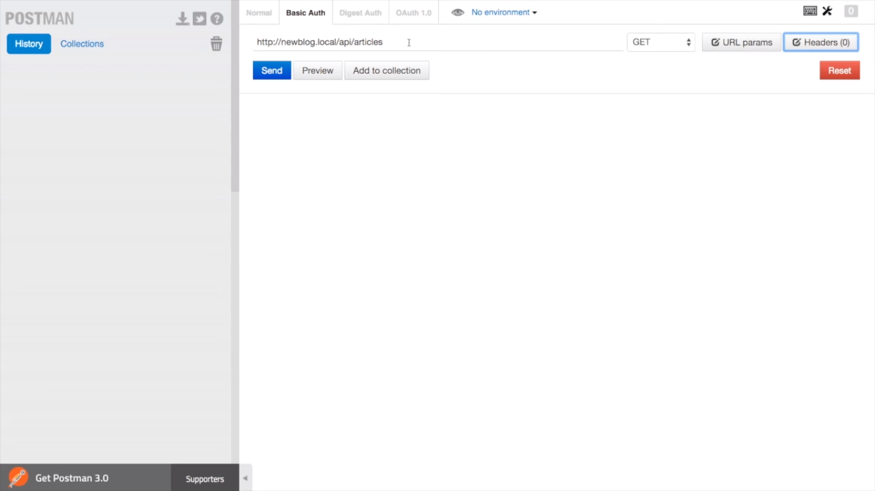
REST API Configration

Slide 16
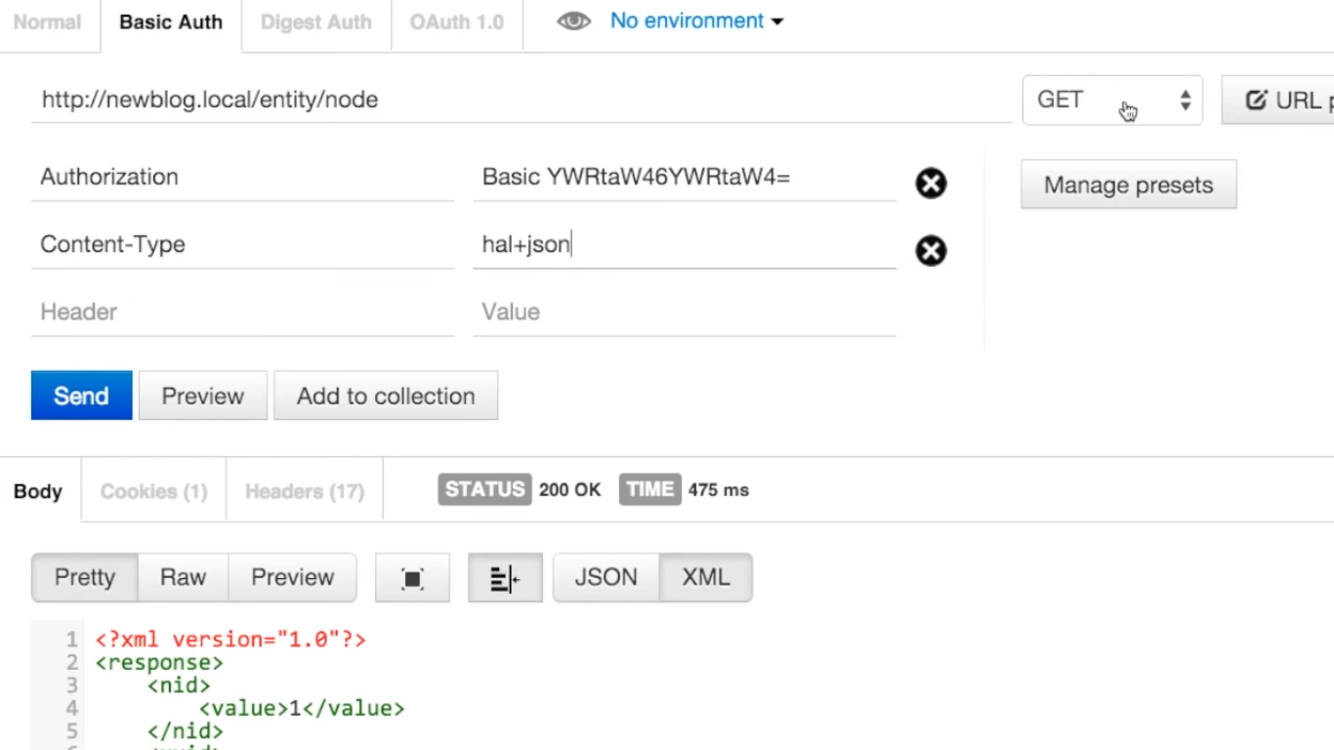
REST API Configration

Slide 17
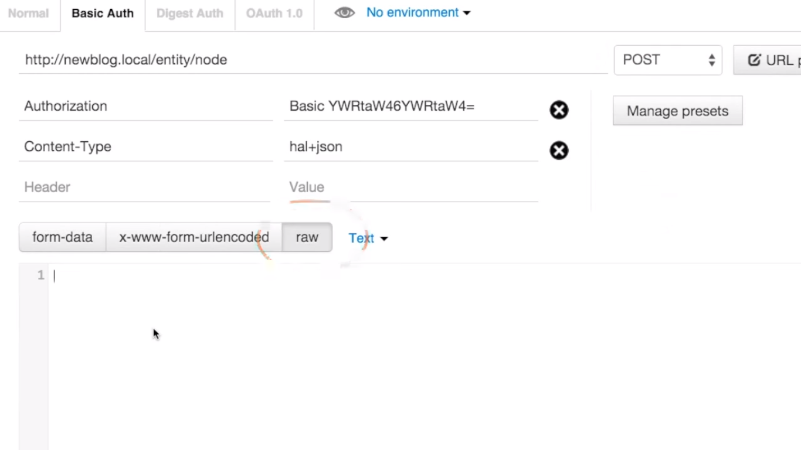
REST API Configration

Slide 18
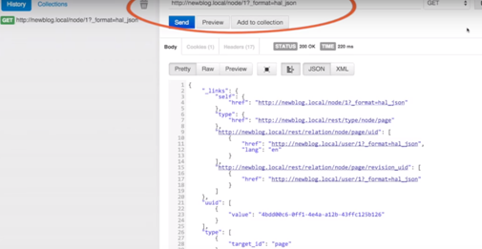
REST API Configration

Slide 19
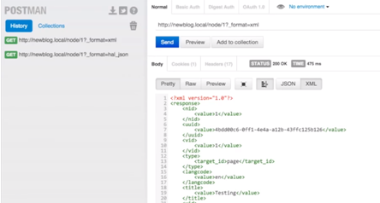
REST API Configration

Slide 20
REST API Configration
After installing the rest client, go to the path "chrome://apps/" on your Google Chrome browser or click the "Apps" icon on the bookmarks bar of your Google-Chrome browser. Then select the "Advanced REST client" application.

Slide 21
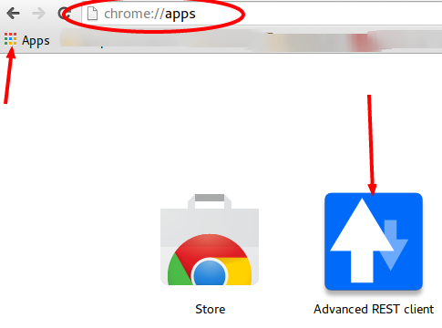
REST API Configration

Slide 22
REST API Configration
In "Advanced REST client", we need to provide the path of the end point. Here our path is “http://localhost/rest/export/json/article”. Select "GET" and click "Send" as shown in the following picture.

Slide 23
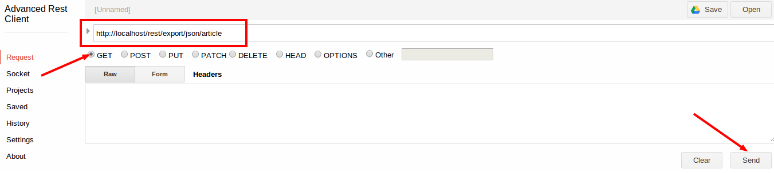
REST API Configration
After you send the request, you will get a response "Status Code: 200 - OK", which is a standard response for successful HTTP requests. This is how the successful response looks:

Slide 24
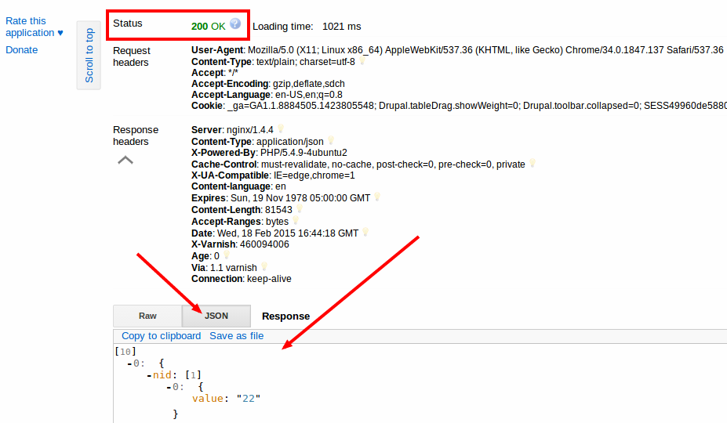
REST API Configration

